Slide 1
DNA

Slide 3
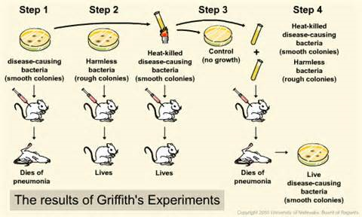
Griffith
Mm
Transformation – one strain changes into another (DNA was transferred)

Slide 4
DNA
Through many scientists and many studies….we now know DNA is what carries the info from one generation to the next.
We now know that DNA is a double helix composed of nucleotide monomers.

Slide 5
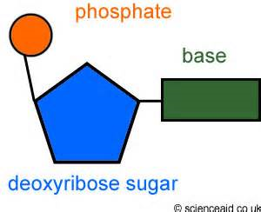
nucleotides
All DNA nucleotides are made of 3 parts:
5 carbon sugar- deoxyribose
Phosphate group
Nitrogen containing base

Slide 6
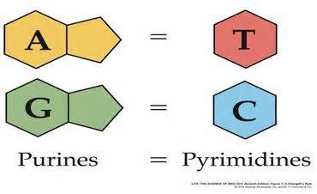
Nitrogen base
Are 4 different bases grouped into 2 types:
Purines – adenine (A) and guanine (G)
Pyrimidine -thymine (T) and cytosine (C)

Slide 7
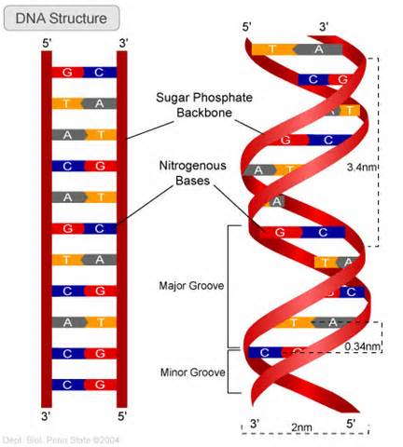
Watson and Crick
Discovered DNA consists of 2 strands of nucleotides, twisted around each other= double helix

Slide 8
DNA structure
The sides of the ladder are the sugar and phosphates
The rungs are the nitrogen bases bonded together
The bases attach to the sugar (not the phosphate)
Hydrogen bonds between the bases on each side hold the 2 strands together

Slide 9
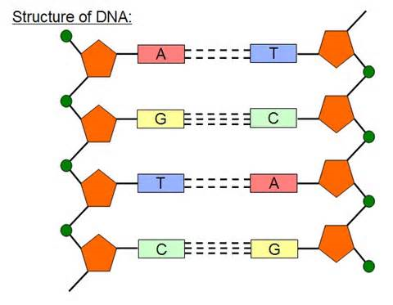
j

Slide 10
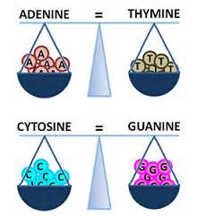
Chargaff’s rules
Base pairing: the nitrogen bases can only bond between specific pairs
Adenine – Thymine A=T
Cytosine – Guanine C=G

